Slide 1
ORL 5524-Sessions 6-8
Instrument Design and Validation
Domain Specification
Madhabi Chatterji, Ph.D.
Professor of Measurement, Evaluation and Education
Director, Assessment and Evaluation Research Initiative (AERI)
Teachers College, Columbia University

Slide 2
AGENDA
LAST WEEK- VALIDATION PLANS
THIS WEEK- HOW TO SPECIFY THE DOMAIN
Domain specification guidelines for cognitive, affective, health and social constructs
Chapters 6-9 in EA (Chatterji 2003) and enrichment readings
Also: Chapter 4 of my new book (Chatterji, in press, Guilford)

Slide 3
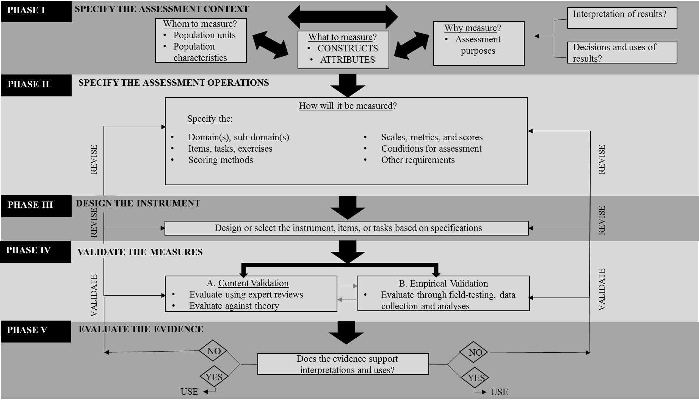
Process Model: V. 2.0

Slide 4
Constructs of Interest?
  Cognitive construct
  Non-cognitive constructs
    Affect
    Beliefs
    Behaviors
  Health-related constructs
  Social constructs
  Methods: Domain-sampling technique vs. empirical methods of scale development

Slide 5
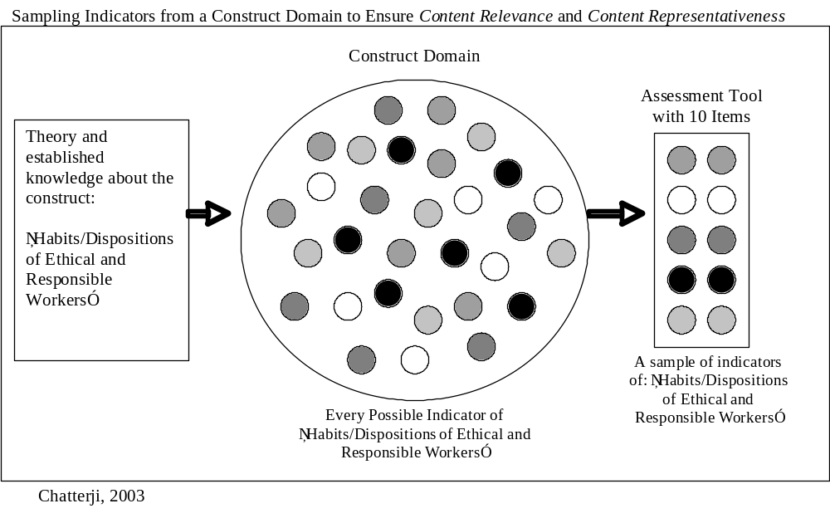

Slide 6
Specifying the construct domains/subdomains: Steps
Choose Data Sources: Use the theoretical literature, research, case studies, focus groups/ and group consensus processes and expert/practice-based knowledge
Organize indicators: Organize indicator statements from general to specific (in the form of a tree-diagram)
Write clear indicator statements :To clarify what you are measuring, parse indicator statements into component parts –e.g., behavior, content, condition, criterion performance
    Use a suitable taxonomy to clarify indicators: Label what you are aiming to tap or measure
      What types of mental, attitudinal or behavioral processing do you want to tap?
Create sample tasks of items: Items to match what the indicator is trying to tap

Slide 7
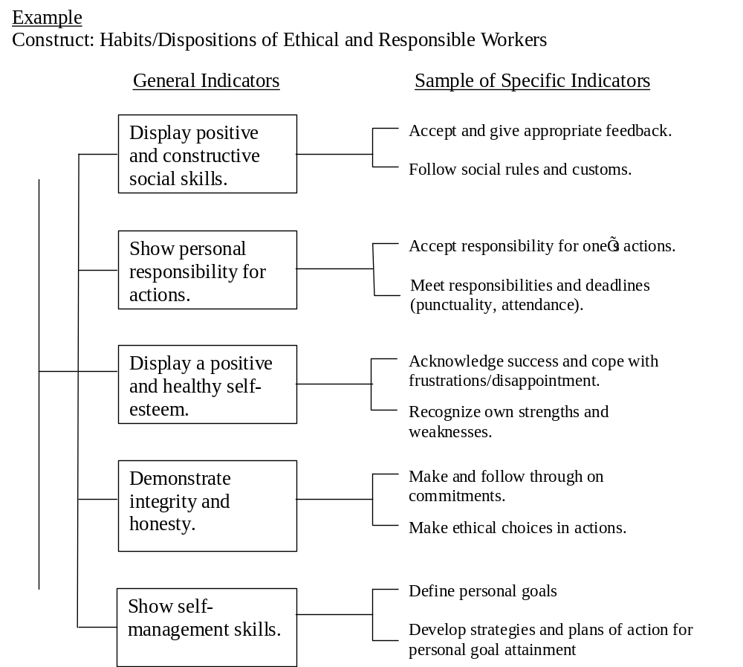

Slide 8
Writing cognitive indicators- Guidelines
Four potential parts: Content, cognitive “behavior”, conditions, criterion performance
Start with an observable verb, or “action”-oriented descriptive verb
  Better: Apply, Use, Distinguish, Identify, Describe, State, Analyze, Synthesize, Compare, Evaluate, Create, Compose, Design
  Weak: Understand, Know, Discuss (Exceptions: when a culminating indicator is broad, it may be vague but works if broken down further into component skills/enablers)
  Alternative statements:
  Calculate the area of a room.
  Given length and width measurements, calculate the area of a room.
  Given length and width measurements, calculate area of two-dimensional spaces with an 80% accuracy rate.

Slide 9
Higher Order Mathematical Problem Solving Heuristic Ability (HOMPSHA)for elementary grade students—DOMAIN INDICATORS AND ITEM EXAMPLES
  1.1 General Indicator: Given a mathematical sequence, student/examinee will recognize the pattern and continue it to solve mathematical problems (Complex procedural skill)
  Specific Indicators:
  1.1.1 Define a pattern in the terms of a sequence of numbers/numerals or quantities
  (Concept Knowledge)
  1.1.2 Apply the reasonable math strategy to identify the mathematical pattern (Complex procedural skills)
  1.1.3 Calculate the sum of the terms of a sequence of numbers, terms or quantities (Application)
  1.1.3 Explain the problem solving process using mathematical reasoning and terms. (Higher Order Thinking)
  Matching Item:
  Calculate the product of (1+2)+(2+3)+ (3+4)+…….+(9+10)=
  (a) 98
  (b) 99
  (c) 100
  (d) 109
  (e) None of the above
  _______________________________________________
  Explain how you arrived at your answer (1-2 sentences):

Slide 10
Useful Taxonomies—Cognitive Constructs
Cognitive construct indicators typically tap into:
Concept knowledge--concept recall and concept comprehension
state (a definition of norm-referenced testing),
paraphrase (the meaning of a passage),
give examples (of a noun and a verb),
(OR distinguish between, say in your own words.)
Application skills--applying concepts, rules, principles, procedures
apply (a formula to find the area of a room)
Complex procedural skills -- multi-step and integrative processes to solve a problem or perform a complex task, usually following accepted conventions in a discipline or field
follow a scientific method (to perform a biological experiment)
Higher order thinking and problem-solving--one or more intellectual skills involving analysis, synthesis, or evaluative processes in open-ended problem-solving situations
Create or compose (a poem),
Model (develop a model)
Compare/contrast (the domain-sampling and empirical methods of instrument design),
(OR critique, defend, justify etc. )
This taxonomy is adapted from Bloom et al (1956) , Marzano et al ( 1995) and from
Chatterji’s functional taxonomy (2003).

Slide 11
Parsed general indicator—an illustration
  General Indicator:
  Given a mathematical sequence [condition],
  student/examinee will recognize the pattern, continue it, and calculate the sum of the terms [cognitive behaviors/mental processes]
  mathematical sequences and pattern [content]
  Taxonomic level: e.g., application, complex procedural skill, etc.

Slide 12
Proficiency in Long Division: Specified Domain
Given a real life problem scenario, students will be able to solve multi-step problems that require addition, subtraction, multiplication, and division of 1-3 digit numbers with 80% accuracy .
Embedded skills/enabling competencies:
  Translate/restate the word problem in mathematical terms
  Select only relevant information to solve the problem
  Recall multiplication tables/facts
  Apply steps in long division to a real life problems
  Multiply, add and subtract numbers with more than 1 digit numbers
  Plan the correct sequence for using mathematical operations (Division>multiplication>subtraction> addition --DMSBAR)
  Check answers by reversing the order of operations
  Solve a multi-step math problem involving mathematical operations (addition, subtraction, multiplication, and division )

Slide 13
LONG DIVISION
Item designed to tap entire domain of skills. Is it content valid?
Problem:
175 math textbooks were delivered to your school. The books need to be distributed in 5 classrooms with equal numbers of students. What is the highest number of students that each class can have so that every child gets one (1) book ? Choose the best answer.
      a) 31 students
      b) 32 students
      c) 33 students
      d) 34 students
      e) 35 students
How many will be left over for the teacher? Explain. ____

Slide 14
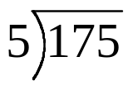
Are these content-valid items?
Two items matched to Long Division domain
Item example | Indicators
Part 1 Look at the problem below to answer Questions 1-6. 1. The problem is telling me to: Multiply 5 times 175 Find out how many groups of 5 are in 175 Divide 5 into 175 equal parts Add 5 and 175 Do something else (explain): | Students correctly restate what the math problem is asking.

Slide 15
Two Developmentally-Ordered, Diagnostic Assessment Tasks in Long Division Unit
Item example | Indicator
I began to do the following problem but know I have made some mistakes. Please find and mark my mistakes. Then, show me how I could fix them by re-doing the problem. 610 9) 552 -54 12 9 3 -0 3R

Slide 16
Non-cognitive Constructs-Writing Indicators
Construct:
Attitude towards formative assessment [“formative assessment” here is the attitudinal object”]
Population: Teachers
Teachers express or endorse:
  Beliefs in the philosophy of formative assessment—e.g., continuous development of students in domains. [C]
  b. Positive sentiments regarding formative assessment. [A]
  c. Practicing and exercising formative assessment with students. [B]
CAB = The 3 dimensions of attitudinal constructs (Tri-partite theory of Attitude Measurement)
C= “Cognitive” aspect deals with beliefs about or perceived awareness/knowledge of something [“cognitive” here does not denote intellectual skills and abilities]
A= Affective aspect deals with feelings about something
B= Behavioral aspect deals with actions or practices related to something

Slide 17
Useful Taxonomies—
Non-cognitive constructs
Affective or attitudinal indicators typically tap into one of the CAB dimensions:
“COGNITIVE component of dispositions”*: Perceived Awareness or Knowledge, Perceptions, Beliefs, Opinions and Values—
What a person holds to be true about something (e.g., schooling is important)
AFFECTIVE component of dispositions: Feelings—
  What a person feels towards an object (satisfaction, fear, happiness, anxiety about schooling.)
CONATIVE component of dispositions, or behavioral and practice-related elements—
  What a person would do in relation to an object
  (run, stay, engage, participate)
EXPERIENTIAL component of dispositions
A person’s recollected past experiences with something
(Could be Affective--pain, satisfaction; or “Cognitive”—perceptions of its value)
This taxonomy is adapted from the original y Rosenberg & Hovland (1960) and from Chatterji (2012). See also Chatterji (2003, Chapter 9).

Slide 18
Measuring teacher attitudes in formative assessment--
Teacher Behavior/Practice Indicators and Matching Items in the Behavior Dimension of CAB
General Indicator 2.0 Demonstrates diagnostic classroom assessment practices while teaching
Specific Indicators | Matching items
2.1 Clarifies targeted goals, outcomes, and embedded competencies on a continuum 2.1.1 Identifies embedded learning outcomes, concepts and skills from a culminating target (problem or task) 2.1.2 Designs/uses ordered items or tasks that test mastery of embedded concepts and skills in a unit 2.1.3 Gauges difficulty of goals vis-à-vis student background levels 2.1.4 Designs/uses pre-tests, homework, quizzes and class work exercises to assess student learning needs formatively. 2.1.5 Evaluates difficulty of assessment tasks vis-à-vis student levels and learning targets | 1. I use more difficult problems in my early unit assessments to identify student needs. 2. I break down my goals for a unit to match the different levels of students. 3.. I give homework exercises to check where students are in learning new goals for a unit. Answer options: All the time, Most of the time, Some of the time, Not at all

Slide 19
Useful Taxonomies 3—Health Constructs
Health construct indicators typically tap into symptoms of a physiological or health condition:
Physiological symptoms ( i.e., heart rate, etc)
Behavioral symptoms (i.e., what a person will do in a given circumstance, like stumble, etc. )
Physical Appearance indicators (i.e., what a person looks like, redness, pale, gaunt, etc.)
Communicative symptoms (how a person communicates, e.g., stutter, incoherent)
Example of using case studies to classify and identify indicators

Slide 20
SPECIFYING THE DOMAIN-Health Construct Example
Construct: Sleep apnea in children, ages 2-6
Domain indicators
The child :
Snores audibly [content/behavior] while sleeping [condition] daily or on a regular basis [criterion].
Is restless [content/behavior] during sleep [condition ] on a daily or regular basis [criterion] .
Pauses, gasps, or may actually stop breathing, [content/behavior] during sleep [condition] on a daily or regular basis [criterion] .
Sample Item on a Parent/Caregiver Survey:
How often does your child snore during sleeping?
Very often (every day), Often (3-5 times a week), Somewhat often (<3 times a week), Rarely (<1 time a week) or Not at all

Slide 21
Practice (Homework)
Specify the domain to measure the construct, automobile driving proficiency in adults 18+years living in the U.S.
Specify the domain to measure an attitudinal construct (e.g., attitude towards drunk driving laws) related to automobile driving by adults 18+years living in the U.S.

